Slide 1

CAPSTONE PROJECT
CYBERSECURITY FUNDAMENTALS
KEYLOGGERS
PRESENTED BY
A.MOHAMMED AADIL
110121104057
AALIM MUHAMMED SALEGH COLLEGE
ENGINEERING

Slide 2
Problem Statement
1
Data Breach
2
Lack of Awareness
Keyloggers can lead to serious data breaches, compromising the privacy and security of individuals and organizations.
Many users are unaware of the presence of keyloggers, making them vulnerable to cyber attacks.
3
Legal Implications
There are complex legal issues surrounding the use of keyloggers, which can lead to ethical and regulatory challenges.

Slide 3



Proposed Solution
Security Measures
User Education
Advanced Technology
Implement robust security measures to detect and prevent keylogger attacks.
Educate users about the risks of keyloggers and how to protect their devices.
Utilize advanced technologies to detect and remove keyloggers from devices.

Slide 4
System Approach
User Perspective
Technological Perspective
Users must be equipped with guidelines and support to prevent keylogger attacks.
Employ innovative technological solutions to ensure the detection and elimination of keyloggers.

Slide 5
Algorithm and Deployment
Algorithm Development
Engineer advanced algorithms to identify and combat evolving keyloggers.
Deployment Strategies
Deploy security protocols to safeguard against keylogging threats in real-time.

Slide 6
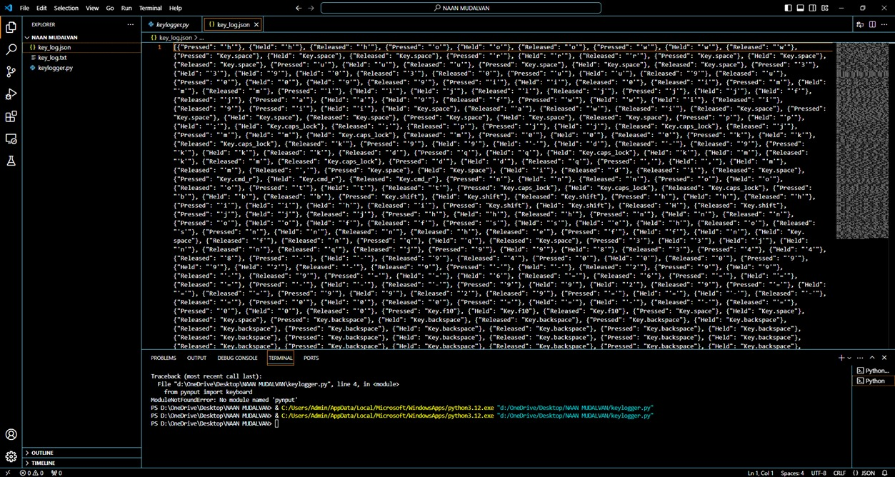
OUTPUT OF KEYLOGGER IN JSON FILE

Slide 7
OUTPUT OF KEYLOGGER IN THE TEXT FILE

Slide 8



Conclusion
Educational Campaigns
Launch educational campaigns to raise awareness about keyloggers and their risks.
Collaborative Efforts
Encourage collaborative efforts between cybersecurity experts and technology developers to combat keyloggers.

Slide 9
Conclusion and key takeaways
Continuous Vigilance
Legal Framework
Global Impact
Vigilance and proactive measures are essential to combat the sophisticated nature of keyloggers.
There is a critical need for a comprehensive legal framework to address keylogger-related cybercrimes.
Keyloggers pose a global threat to online security, necessitating urgent action.

Slide 10

Future Scopes
1
Technological Advancements
Anticipate future technological advancements to counter emerging keylogger threats.
2
Regulatory Development
Expect the development of more stringent regulations to address keylogger-related cybercrimes.
3
Enhanced Collaboration
Emphasize enhanced collaboration between global entities to strengthen cybersecurity against keylogger attacks.

Slide 11
THANK YOU

